Slide 1
Manufacturing Readiness Level (MRLs)
& MRL Assessments
Executive Overview
Notes:
This presentation is intended to serve as an executive level overview of Manufacturing Readiness Levels (MRLs) and MRL Assessments.

Slide 2
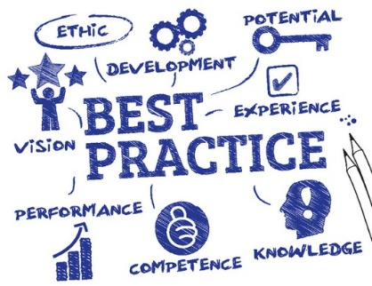
What are MRLs?
Common language and standard for:
  Assessing the manufacturing maturity of a technology or product and the plans for its future maturation
  Helping to understand the level of manufacturing risk in producing a system or transition technology into a system application
Designed to complement Technology Readiness Levels
Not pass/fail criteria
Designed to provide decision makers (at all levels) with a common understanding of the relative maturity (and attendant risks) associated with manufacturing technologies, products, and processes
A Risk Identification Tool
Notes:
MRLs are a common language to assess and communicate the level of manufacturing maturity and a tool to identify risks.

Slide 3
MRL Relationships
Defense Acquisition Phases
System Acquisition Milestones
A
B
C
Capabilities Based
Planning /Concept
Development
Materiel Solution Analysis
Technology Maturation & Risk Reduction
Engineering & Manufacturing Development
Production & Deployment/ Operations & Support
MRL 1
Basic
Manufacturing
Implications Identified
MRL 2
Manufacturing
Concepts
Identified
MRL 3
Manufacturing
Proof of Concept
Developed
MRL 4
Manufacturing
Processes
In Lab
Environment
MRL 5
Components
In Production
Relevant
Environment
MRL 6
System or
Subsystem
In Production
Relevant
Environment
MRL 7
System or
Subsystem
In Production
Representative
Environment
MRL 8
Pilot Line
Demonstrated
Ready for
Low Rate Initial
Production (LRIP)
MRL 9
LRIP
Demonstrated
Ready for
Full Rate
Production (FRP)
MRL 10
FRP
Demonstrated
Lean Production
Practices in
Place
Manufacturing Readiness Levels
Manufacturing Readiness Levels
TRL 1
Basic
Principles
Observed
TRL 2
Concept
Formulation
TRL 3
Proof
of
Concept
TRL 4
Breadboard
in
Lab
TRL 5
Breadboard
in
Relevant
Environment
TRL 6
Prototype
in
Relevant
Environment
TRL 7
Prototype
in Operational
Environment
TRL 8
System
Qualification
TRL 9
Mission
Proven
Technology Readiness Levels
Notes:
The top row of this chart depicts the life cycle phases of a typical, major DoD acquisition program. Major decision Milestones A, B, and C are required to be successfully passed to enter the next life cycle phase or exit the Middle Tier Acquisition phase. Manufacturing maturity and risks are addressed as a critical part of these milestone reviews.
Refer to the MRL Deskbook and User’s Guide for applying MRLs to other DoD Acquisition Pathways.
The MRLs go from 1 to 10, with MRL 10 being the highest level of manufacturing maturity.
MRLs are not pass-fail criteria or requirements. A program is not required to be at a certain level in order to proceed to the next phase. Rather, these are the targets which a program is measured against to identify manufacturing risks.
The Target MRL for Milestone A is MRL 4; the Target MRL for Milestone B is 6; and the Target MRL for Milestone C is 8.
The second row shows some key terms in the MRLs that are important to defining each level in terms of the type of environment expected at that phase (such as relevant production environment, representative production environment, etc.) We will discuss these in an upcoming chart.
The MRLs are loosely correlated to the TRLs.

Slide 4
9 MRL Evaluation “Threads”
Technology and Industrial Base
  Technology maturity, technology transition to production, ManTech development
Design
  Producibility program, design maturity
Cost and Funding
  Production cost knowledge (cost modeling), cost analysis, mfg investment budget
Materials (raw materials, components, subassemblies, subsystems)
  Maturity, availability, supply chain management, special handling
Process Capability and Control
  Modeling & Simulation (product & process), mfg process maturity, process yields/rates
Quality Management, to include supplier quality
Manufacturing Personnel, to include specialization, training, & certification
Facilities, to include capacity and plant layout & design
Manufacturing Management
  Manufacturing planning and scheduling
  Materials planning
  Tooling and special test equipment
  Operational Technology Cybersecurity
Notes:
The major areas that MRLs evaluate are called “Threads.”
These threads cover the most important topics that must be assessed to determine manufacturing maturity.

Slide 5
MRL Manufacturing Environment Definitions
Terms defined by the MRL Deskbook:
Laboratory Environment – An environment where scientists, design engineers, manufacturing engineers, quality engineers, and production personnel develop and test processes, procedures, and equipment for making a product. ~ MRL 1 - 4
Production Relevant – An environment with some shop floor production realism present (such as facilities, personnel, tooling, processes, materials etc.). ~ MRL 5 & 6
Production Representative – An environment that has as much production realism as possible, considering the maturity of the design. ~ MRL 7
Pilot Line – An environment that incorporates all of the key production realism elements (equipment, personnel skill levels, facilities, materials, components, work instructions, processes, tooling, cleanliness, lighting etc.). ~ MRL 8
Production Line – An environment that incorporates all capabilities required to manufacture production configuration items, subsystems, or systems. ~ MRL 9 & 10
Notes:
All parties must use these terms in conducting the MRL Assessments. They provide consistent definitions for maturity levels
Laboratory Environment
Results should be used to assess producibility, manufacturability, and new equipment, processes, and procedures
Production relevant
Minimum reliance on laboratory resources
Must be an indication of how the contractor(s) intend to achieve the requirements in a production representative and pilot environments.
Production representative
Production personnel, equipment, processes, and materials that will be present on the pilot line should be used whenever possible.
High-quality work instructions and tooling should be in place;
No reliance on a laboratory environment or personnel.
Pilot line
Required to meet design requirements in low rate production.
To the maximum extent practical, the pilot line should use full rate production processes.
Production line
Must meet design requirements utilizing manufacturing processes and procedures that are under control
Must be capable of meeting required rate and quantities.

Slide 6
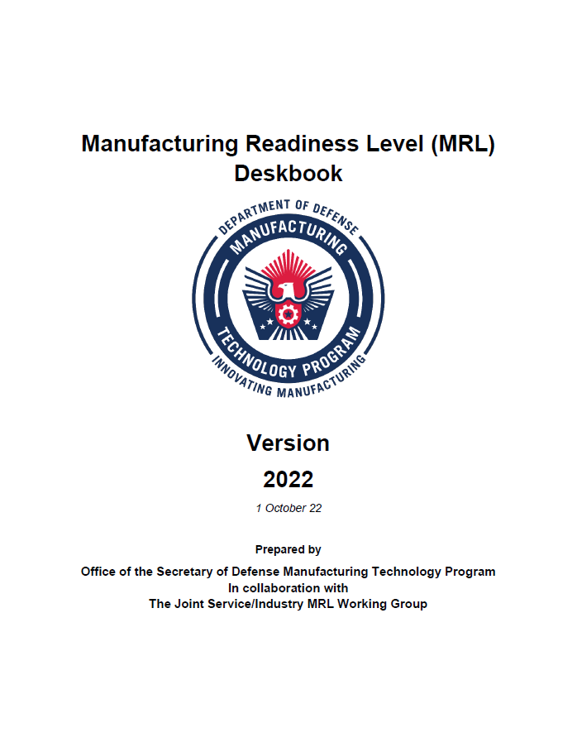
MRL Body of Knowledge – Deskbook
Narrative document:
  Defines MRLs and Criteria
  Explains Manufacturing Readiness Assessment (MRA) process and Manufacturing Maturation Plan (MMP) format
  Provides contracting language and tailoring guidelines
“Living” document
Contains MRL Criteria Matrix as an appendix
The MRL Body of Knowledge is at: dodmrl.org
Notes:
The MRL Body of Knowledge consists of three primary documents: The MRL Deskbook, the Criteria Matrix, and the User’s Guide. These can all be found at the website: dodmrl.org
The first of these documents is the MRL Deskbook. This is published by OSD and the MRL Working Group, which is chartered by the Joint Defense Manufacturing Technology Panel.
It explains what MRLs are, defines key terms, describes how to conduct MRL assessments, and provides contractual language and tailoring guidelines.
The Deskbook is updated regularly to incorporate evolving DoD policies, process improvements, and lessons learned.

Slide 7
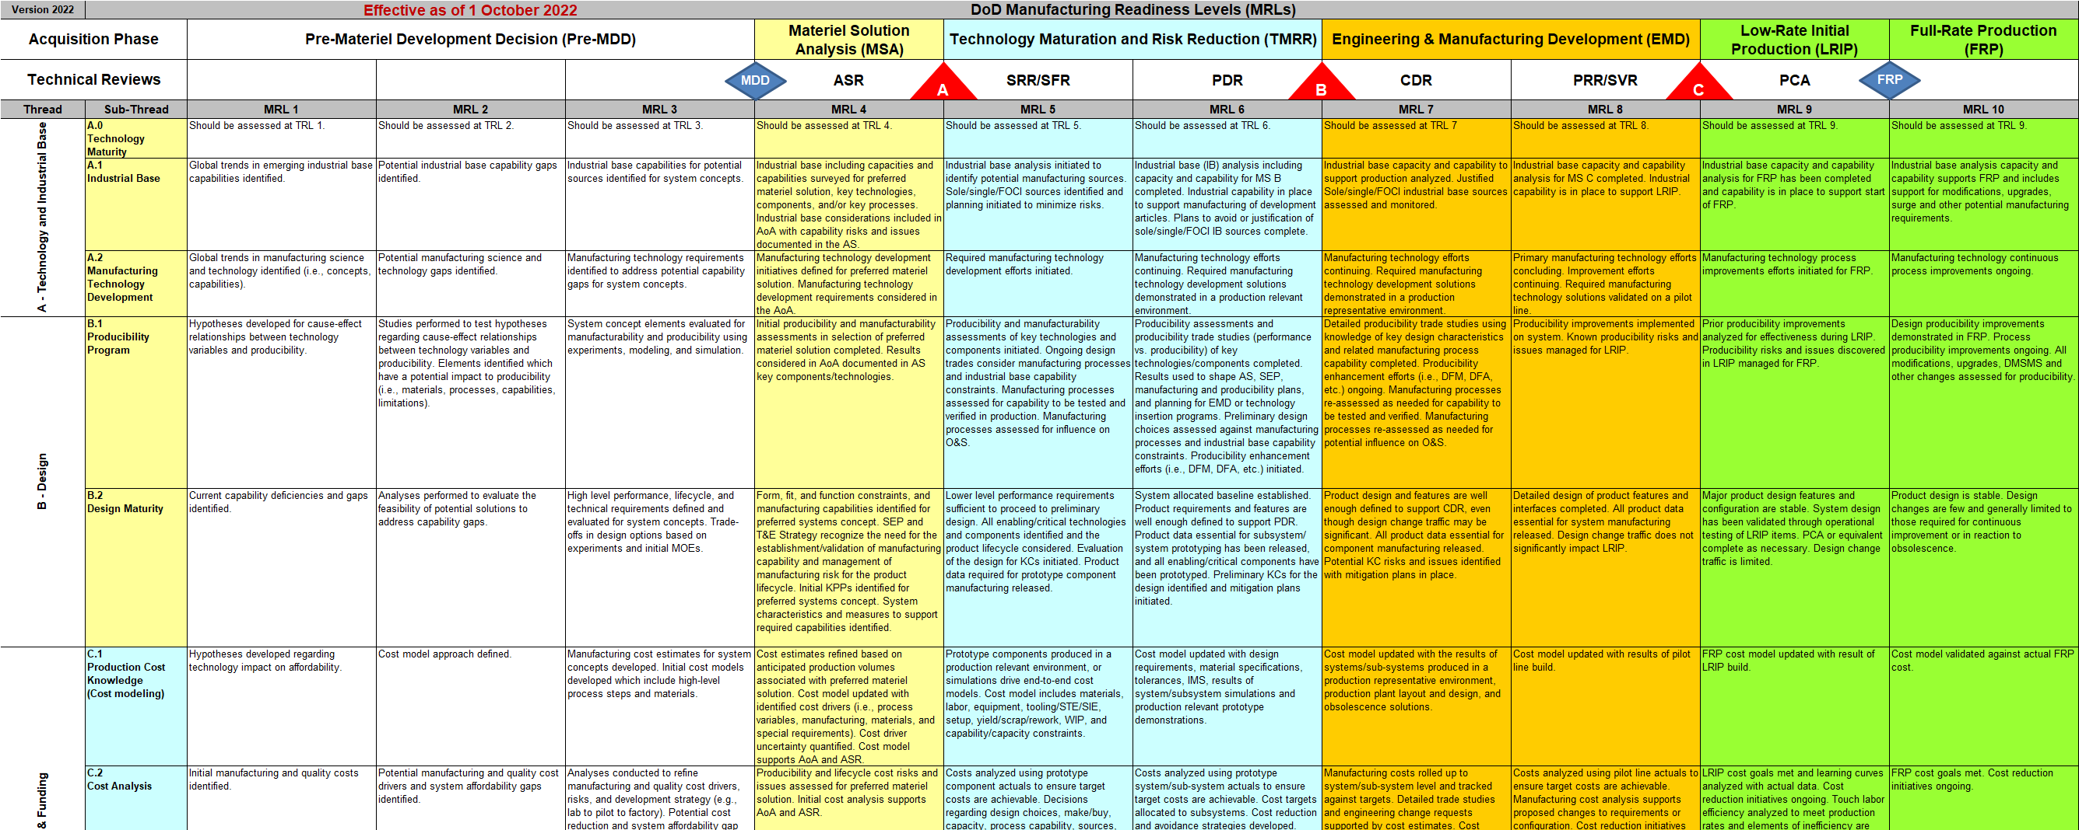
MRL Body of Knowledge – Criteria Matrix
Excel spreadsheet containing all criteria organized by:
  MRL timeline (column)
  Subject thread (row)
Included within the MRL User’s Guide file at dodmrl.org
Notes:
The core of the MRL process is the MRL Criteria Matrix. It is the basis upon which MRL assessments are conducted. This chart depicts an excerpt of the matrix.
The threads to be assessed are in the left column.
Across the top are the product lifecycle phases and major program milestones.
The criteria for each thread are in the body of the matrix, with the criteria reflecting expectations of increasing maturity going from left to right.
This matrix can be found as a stand-alone file at dodmrl.org or as part of the MRL User’s Guide file, also at that same website.

Slide 8
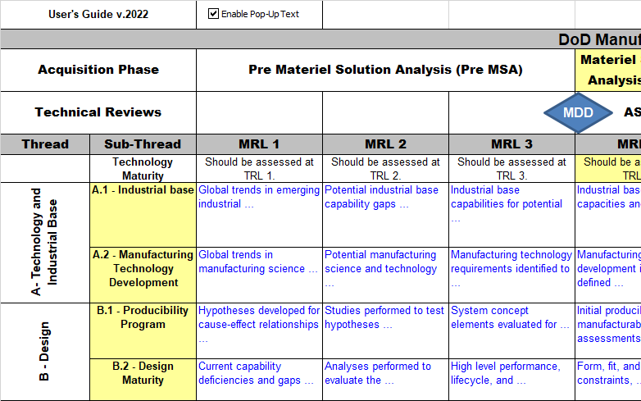
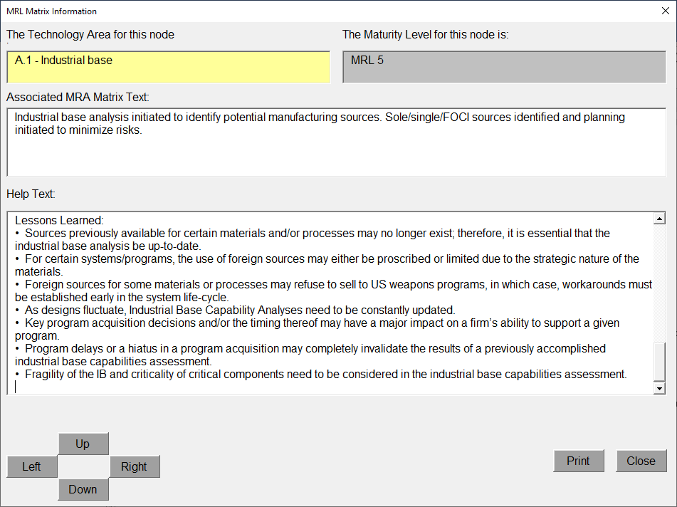
MRL BoK – User’s Guide
Interactive document
Supports MRL assessments:
  Contains cross-referenced definitions, criteria, explanatory notes, best practices and MRL appropriate questionnaires
  “Mimics” Criteria Matrix
Has:
  Printable Criteria Matrix
  MRL Questionnaire
  Pop-Ups with additional information for each criteria
Notes:
The MRL User’s Guide is an Excel Spreadsheet that contains numerous useful tools.
The User’s Guide has a printable Criteria Matrix and a questionnaire that takes each criteria and puts them in the form of a question. The questionnaire can be sorted by thread and by MRL level and can serve as the starting point for tailoring the list of questions to be addressed.
The Guide also has a version of the MRL matrix where every cell is a link to a pop-up guide for that specific cell and criteria.
The pop-up guidance contains a description of the purpose of the criteria; reference sources; examples of potential artifacts that can be used to show objective evidence the criteria has been met; additional questions that can be asked to delve deeper; and lessons learned on the topic being assessed.

Slide 9
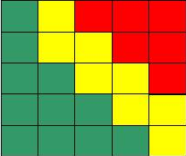
MRL Assessment Conceptual View
Identify Product or Processes (WBS, etc.)
Identify Items to be Assessed
(CTE, WBS or
Filter Questions)
Develop
Risk
Mitigation
Plan(s)
[Manufacturing
Maturation
Plan(s)]
Identify
Program
Phase
Conduct
Assessment
Determine
MRL Criteria
Assess Risk
Monitor & Follow-Up
Notes:
This is an overview of the MRL assessment process.
The first step, which is sometimes the most difficult, is to determine which items, processes, or suppliers should be assessed. The MRL Deskbook has some tools to help determine that.
Determining which MRL criteria to be assessed is primarily based on the phase the program is in and which milestone is coming up. The criteria can also be tailored based on the unique program needs and environment.
The assessment is then conducted (usually on-site) and risks are identified and assessed.
Manufacturing Maturation Plans, also called Risk Mitigation Plans, are developed to address each risk, and their implementation is monitored to ensure they are completed effectively.

Slide 10
MRL Assessment Goal
Identify the As-Is State: defines the current level of manufacturing maturity
Determine the Should-Be State (i.e., Target MRL)
  Identify gaps and maturity shortfalls (if any) and associated risk drivers
  Develop strategies to reach the Should-Be State
    Provides the basis for manufacturing maturation and risk management
    Includes planning, identification, analysis, mitigation, implementation, and tracking
Notes:
The goal of the MRL assessment is to identify the as-is manufacturing maturity state of the product, process, or supplier. In other words, where are they at in terms of manufacturing maturity and to which MRL does that correspond?
The next step is to compare that to the target MRL, or where they should be at, given the phase of the program.
When the as-is level is less than the target level, this is a gap or maturity shortfall. A Manufacturing Maturation Plan (or risk mitigation plan) must be developed to address this shortfall.
The MMP should address all the actions and resources need to address the shortfall, as well as the anticipated schedule for completing the actions.

Slide 11
The Assessment Process
Self-assessment
  Based on Target MRL and Criteria Matrix
    User’s Guide and Deskbook expound on criteria and provide appropriate “hooks” to guidance
  Identifies supporting evidence/artifacts
  MRA Team reviews self-assessment before on-site assessment
  Provides feedback to company
On-site Assessment
  Company presents summary MRL assessment, company info, and facility tour
  Demonstrate evidence on the production floor
  Determine As-Is MRL using Criteria Matrix
  Begin MMP strategy/risk discussion (i.e., start MMP development)
Notes:
Prior to the on-site review, a proven best practice is to have the organization being reviewed conduct their own self-assessment prior to the on-site assessment.
This self-assessment should be provided to the customer team for review prior to going on-site within an agreed-to time between the customer and supplier. This enables the team to become familiar with potential risks and ensures the organization being reviewed understands the MRL criteria and process. As a result, the on-site review should be much more effective and efficient.
Once on-site, the company should provide an overview of the company, walk the team through their assessment, and conduct a tour of their facilities.
This is also the time for the team to examine objective evidence that the criteria have been met.
Once shortfalls against the target MRL have been identified, the customer and supplier can begin discussing strategies for the Manufacturing Maturation Plans to address the risks.

Slide 12
Post-Assessment Activities
As a Best Practice, Program Office/Contractor/ Supplier will normally collaborate to develop the Manufacturing Maturity Plan (MMP) for MRLs which do not meet the target MRL level.
MMPs address:
  Activities to reach MRL target
  Schedule and Costs
  Considerations for the Milestone Decision Authority (MDAs)
Notes:
A key output of the MRL assessment are the Manufacturing Maturation Plans for areas in which the actual MRL do not meet the target MRL.
The MMPs describe how the target MRL will be met and what activities and resources it will take to accomplish that.
When addressing the activities needed to reach the MRL target, consider including:
What areas were short of the target MRL and why?
What needs to be done to reach target MRL
What is the risk associated with not meeting the target MRL
Address the anticipated schedule and costs in the MMP
Milestone Decision Authorities (and Program Managers) evaluate the risk as assessed in conjunction with the MMP to determine whether or not to proceed to the next milestone
MRAs provide a risk-based assessment of the program’s READINESS to MANUFACTURE and PRODUCE to its intended design
MRAs provide INSIGHT, NOT OVERSIGHT—they are not a report card

Slide 13
The Deployment of MRLs
The MRL Deskbook methodology is recognized and used by both government and commercial industry
SAE Industry Standard AS6500 (Manufacturing Management Program) contains MRLs as a requirement
Some Service instructions require MRLs on acquisition contracts
Congressional language in law requires MRLs on some specific acquisition programs
GAO identifies the use of MRLs as a Best Practice
MRLs are a Best Practice across Defense and Commercial Industries
Notes:
MRLs have become a best practice for assessing manufacturing maturity across both the defense and commercial industries.
DoD Instructions 5000.02 and 5000.88 require the assessment and measurement of manufacturing risk and the MRL process is the accepted methodology for identifying those risks.

Slide 14
Summary
Key manufacturing activities occur in every phase of the Product Life Cycle
Products made by immature manufacturing processes generally:
    Cost more
    Are prone to quality problems
    Experience schedule delays
    May not perform the same
    May be less reliable in service
We need to understand: Manufacturing Maturity & Manufacturing Risk at the contractor and in the supply chain
For additional guidance, visit: dodmrl.org
Notes:
In summary, there are key manufacturing activities that must occur at every phase of the product life cycle to develop manufacturing processes and prepare for production.
If these activities are not executed properly, the program will likely encounter cost, schedule, quality, and performance problems.
It is important to understand, track, and manage the manufacturing maturity and risks throughout the supply chain, so they can be addressed and mitigated to prevent adverse impacts to the program.

